Slide 1
ALL TEACHERS TO OUR CLASS!

Slide 2
A game:
“ PASSING THE BALL”
You pass the ball around the class and listen to the song..

Slide 4
What is Tuan Chau?
Where is Ayres Rock?
How did we get to Ao Vua 2 weeks ago?
What should we bring when we go on a picnic?
How was the trip to Ao Vua?
What should we bring when we go on a picnic??

Slide 5
Tuesday, November 15th, 2016
Unit 5:
NATURAL WONDERS OF THE WORLD
LESSON 2 :
A CLOSER LOOK 1 (P.50)

Slide 6
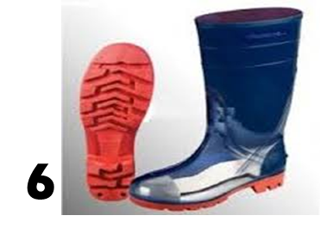
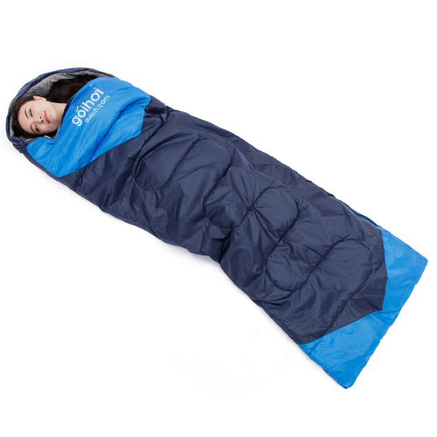
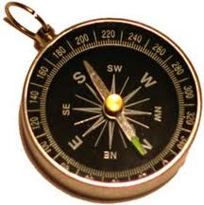
I/ Vocabulary
plaster (n)
painkillers (n)
walking boots
sleeping bag (n)
compass
sun cream

Slide 7
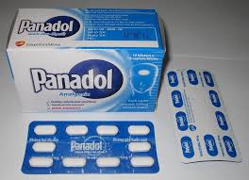
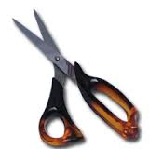
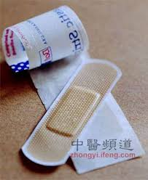
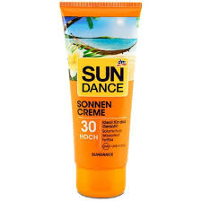
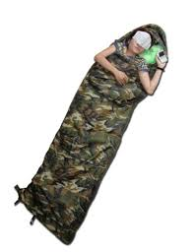
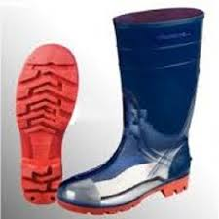
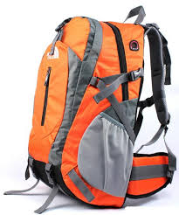
Exercise 1: Match the items
with the pictures.
1
2
a. plaster
b. walking boots
c. painkillers
3
4
d. sun cream
e. scissors
f. sleeping bag
5
6
g. backpack
h. compass
7
8

Slide 9
Exercise 2: Use the items in exercise 1 to complete the following sentences.
We’re lost. Pass me the …………
It’s so hot today. I need to take some ……………
My head hurts. I need to take a ……………
I finished packing. All my things are in my ………...
I walked too much. I need to put a ……………….…. on my foot.
compass
sun cream
painkillers
back pack
walking boots

Slide 10
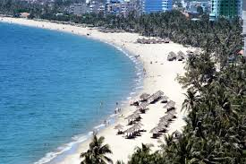
Exercise 3: Order the items from very useful (No.1) to not very useful (No.8).

Slide 11
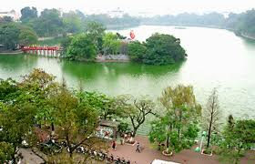
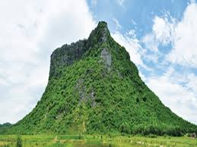
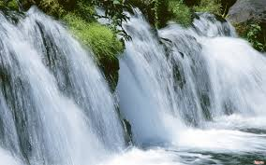
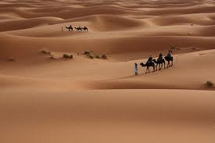
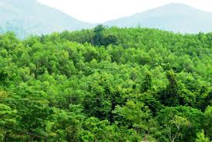

Slide 12
II/ Pronunciation:
desert
forest
boat
confident
front
first
lost
coast

Slide 13
Exercise 4: (p50)
Listen and number the words you hear.
desert
boot
1. best
5. boot
plaster
lost
2. boat
6. desert
forest
boat
3. coast
7. plaster
coast
best
4. lost
8. forest

Slide 14
Exercise 5: Listen and repeat , then put the words in the right column.
/t/ | /st/
boat
best
boot
coast
desert
lost
plaster
forest

Slide 15
Exercise 6: Listen to the sentences and pay attention to the bold – typed parts of the words
1. Swimming in the sea in the summer is best.
2. Ha long Bay has the nicest scenery in Viet Nam.
3. The Amazon rain forest is in Brazil.
4. One day, I want to see the Ayres Rock.
5. The Sahara is the hottest desert in the world.
6. I want to explore the coast by boat.

Slide 16
III/ Further practice
Plan your own picnic to Ao Vua next Friday in groups. Try to use the words with the sounds /t/ and /st/ as many as possible. The expressions and the travel items below may help you.
What shall we do ………….?
Shall we …………………?
Let’s …………………….
I think we ……………….

Slide 17
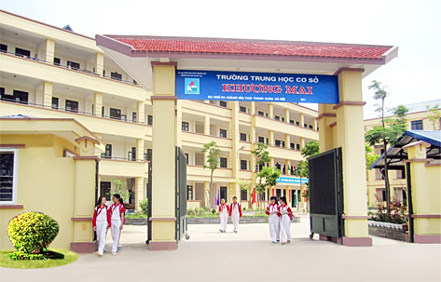
Hi! Nice/ meet/ again
Oh! This weekend
Nice/ meet/ you too

Slide 18
Tom and Tim are Twins. /tɑːm ən tim ɑːr twɪnz/ Thomas ate three hot dogs. /ˈθɔːməs et θriː hɑːt dɔːɡz/ Teddy met them at the market. /ˈtedi met ðəm ət ðə ˈmɑːrkɪt/ The fat cat sat down on the mat. /ðə fæt kæt sæt daʊn ɔːn ðə mæt/ Could you tell me how to get to the train station? /kʊd juː tel mi haʊ tə get tə ðə treɪn ˈsteɪʃn/

Slide 19
HOMEWORK
Learn new words by heart.
Prepare Unit 5: Closer look 2 (P51, 52)
a) Find the short adjectives.
b) Collect the signs of the traffic.

Slide 20
Thank you
for your attendance!

Slide 21
UNIT 5
NATURAL WONDERS OF THE WORLD
LESSON 2
CLOSER LOOK 1 (P50)

Slide 22
Exercise 1: Match the items
with the pictures.
1
2
a. plaster
b. walking boots
c. painkillers
3
4
d. sun cream
e. scissors
f. sleeping bag
5
6
g. backpack
h. compass
7
8

